Slide 1





294955680
493431184
420495904
OAUTH2 and OIDC Implementation
17th December 2025
Presenter : Arun Nagaraju
Building Trust Through Secure Authentication

Slide 2

Agenda
What is Authentication & Authorization?
Old Ways of Authentication
Cons of Traditional Methods
Why OAuth2 and OIDC Are Better
Delegated Authorization with OAuth 2.0
OAuth 2.0 Terminology & Code Mapping
How OAuth2 Works - Authorization Flow
What OpenID Connect Adds to OAuth2
OAuth2 vs OIDC Comparison
PKCE - Enhanced Security
2

Slide 3
What is Authentication & Authorization?
Authentication = Proving Who You Are
Definition:
Process of verifying the identity of a user, device, or system
Answers the question: “Who are you?”
Different from Authorization: “What can you do?”
Real-World Analogy:
🎫 Authentication = Showing your ID at airport security
🚪 Authorization = Boarding pass determines which gate you can access
3

Slide 4
Old Ways of Authentication
Basic Authentication(Username + Password)
Credentials sent with every request
Password exposed in base64(easily decoded)
No granular permissions
Difficult to revoke access
Session-Based Authentication(Cookies)
Server must store session state (scalability issues)
Difficult for mobile/SPA applications
CSRF vulnerabilities
Not suitable for microservices
LDAP/Active Directory
On-premise infrastructure required
Complex setup and maintenance
Limited to internal networks
Poor mobile/cloud support
4

Slide 5
Cons of Traditional Methods
Why Traditional Authentication Falls Short
Issue | Basic Auth | Session-Based | LDAP/AD
Scalability | ❌ Poor | ❌ Stateful servers | ❌ Infrastructure heavy
Mobile Support | ❌ Insecure | ⚠️ Limited | ❌ Complex
Third-party Access | ❌ Share passwords | ❌ Not possible | ❌ Not possible
Microservices | ❌ Not suitable | ❌ Session sync issues | ⚠️ Complex
Token Revocation | ❌ Must change password | ✅ Good | ⚠️ Delayed
API Access | ❌ Credentials exposed | ❌ Cookie-based | ❌ Complex
5

Slide 6
Why OAuth2 and OIDC Are Better
Benefit | Description
🔒 Security | Tokens expire automatically, can be revoked instantly
📱 Mobile-Friendly | Native app support without storing passwords
🌐 Stateless | No server-side session storage needed
🔄 Scalability | Works across distributed systems and microservices
🔌 Integration | Easy third-party app access without credential sharing
🎯 Granular Control | Specific permissions via scopes and roles
Modern Token-Based Authentication
OAuth 2.0 (Authorization Framework)
Delegated Access: Grant access without sharing passwords
Tokens Instead of Credentials: Temporary, revocable access
Scope-Based Permissions: Fine-grained control
Industry Standard: Used by Google, Microsoft, GitHub, Facebook
OpenID Connect (OIDC) - Authentication Layer on OAuth2
Identity Information: ID tokens with user claims
Single Sign-On (SSO): Login once, access multiple apps
Standardized Claims: Consistent user data format
Cryptographic Security: JWT tokens with signature verification
6

Slide 7
Delegated Authorization with OAuth 2.0
What is Delegated Authorization?
Problem:
How can I let a website access my data without giving them my password?
Real-World Example:
🏨 Hotel Analogy:
You (Resource Owner) give a key card (Access Token) to valet (Client)
Key card only opens parking garage (Scope), not your room
Hotel (Authorization Server) issues the key card
Key card expires after checkout (Token Expiration)
OAuth 2.0 = Authorization Framework
Key Principle: Grant limited access to resources without sharing credentials
Why Delegated Authorization?
✅ No Password Sharing: Third-party apps never see your credentials
✅ Limited Scope: Grant specific permissions only (read repos, not delete)
✅ Revocable: Cancel access anytime without changing password
✅ Audit Trail: See which apps have access to your data
✅ Temporary Access: Tokens expire automatically
7

Slide 8
OAuth 2.0 Terminology & Code Mapping
OAuth 2.0 Core Entities
Term | Definition | In Our Project | Code Location
Resource Owner | The user who owns the protected data | GitHub/Azure user (You) | user_info["id"]
Client | The application requesting access | Our FastAPI Application | GITHUB_CLIENT_ID in config
Authorization Server | Issues tokens after authenticating the user | GitHub OAuth, Azure AD | github.com, login.microsoftonline.com
Resource Server | Hosts the protected resources | GitHub API, Microsoft Graph | api.github.com, graph.microsoft.com
Authorization Grant | Credential representing user consent | Authorization Code | code parameter in callback
Access Token | Key used to access protected resources | Token from provider | tokens["access_token"]
8

Slide 9
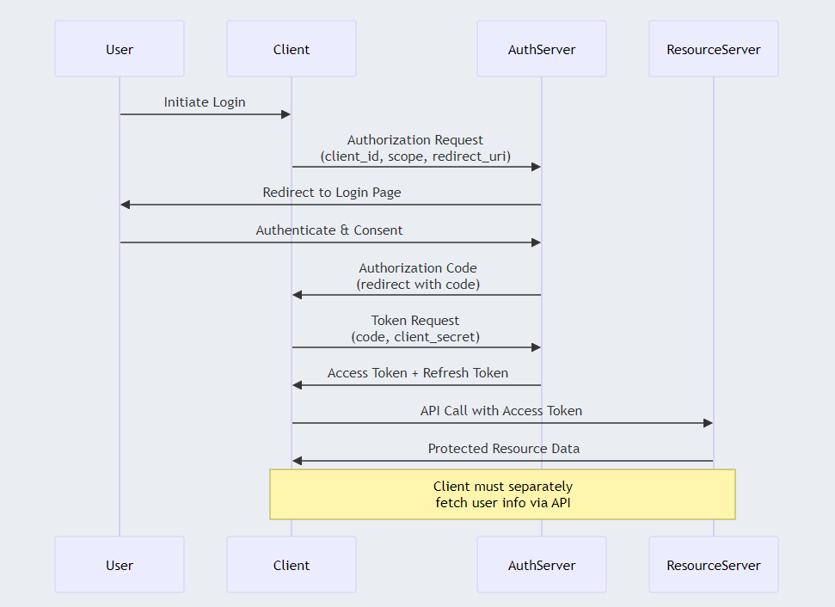
How OAuth2 Works - Authorization Flow
9

Slide 10
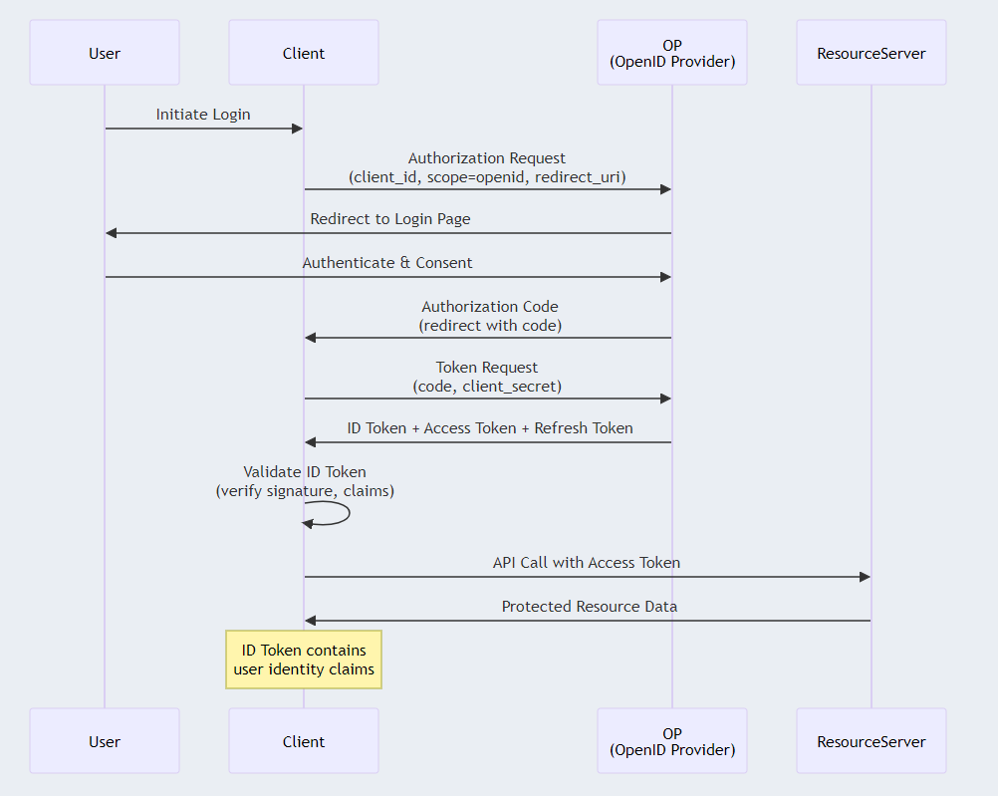
What OpenID Connect Adds to OAuth2
10

Slide 11
OAuth2 vs OIDC Comparison
Feature | OAuth 2.0 (e.g., GitHub) | OIDC (e.g., Azure, Google, Auth0)
Primary Purpose | Authorization (API access) | Authentication + Authorization
Tokens Returned | Access Token only | ID Token + Access Token + Refresh Token ✨
User Identity | Requires API call to /user | Included in ID Token (no extra call) ✨
User Info Format | Provider-specific JSON | Standardized JWT claims ✨
Scopes | Provider-specific | Standardized (openid, profile, email) ✨
Role Information | Manual fetching (e.g., Teams API) | Included in ID Token claims ✨
Token Validation | Opaque token (server-side validation) | JWT signature verification ✨
Implementation | Custom per provider | Consistent across providers ✨
11

Slide 12
PKCE - Enhanced Security
What is PKCE?
PKCE (Proof Key for Code Exchange) is an OAuth 2.0 security extension that protects against authorization code interception attacks. It works by:
Code Verifier: A cryptographically random string generated by the client
Code Challenge: A SHA256 hash of the code verifier sent in the authorization request
Verification: The provider verifies the code challenge matches the code verifier during token exchange
Why PKCE is Important
Prevents Code Interception: Even if an attacker intercepts the authorization code, they cannot exchange it for tokens without the code verifier
Public Client Security: Essential for mobile apps, SPAs, and desktop applications
RFC 7636 Standard: Industry-standard security enhancement

Slide 13
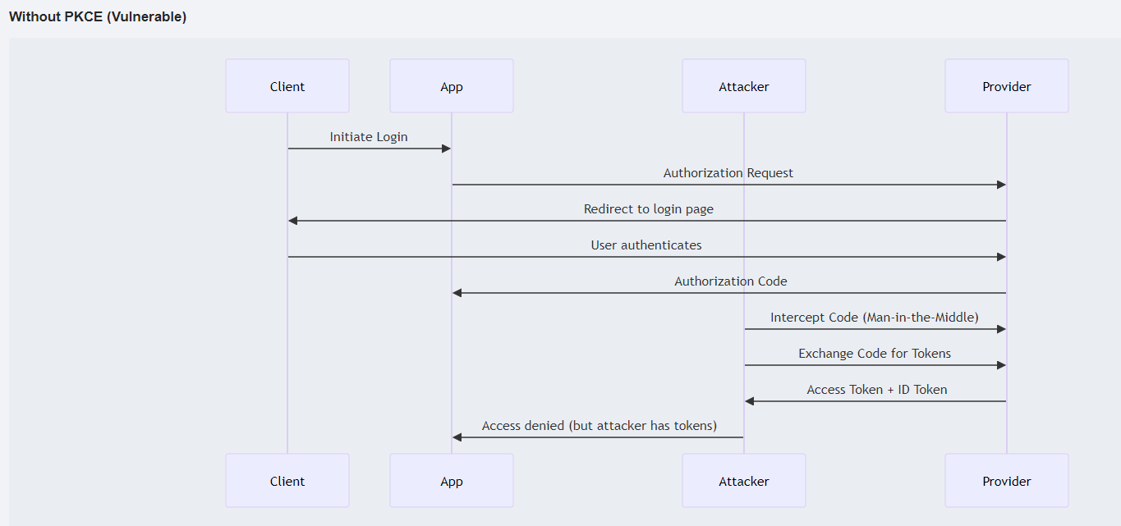
Without PKCE

Slide 14
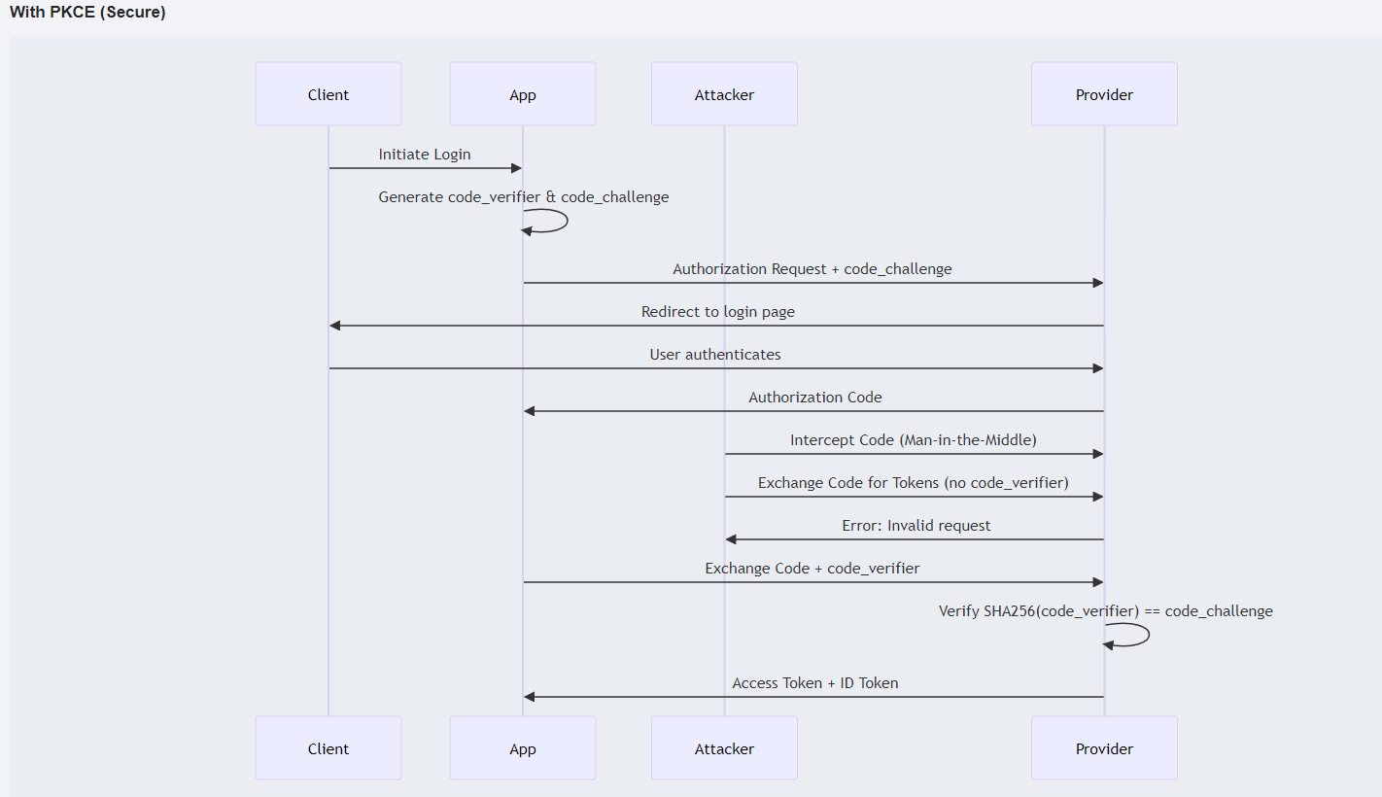
OIDC with PKCE

Slide 15
Q&A?
15

Slide 16



Thank You!

